Slide 1
Exploratory Data Analysis (EDA) : - on Real Estate Pricing
Understanding Factors Influencing House Prices
Presented by: Sawant Dubey
Date: October 04, 2025

Slide 2
Project Overview : -
Goal: Analyze real estate data to uncover insights into factors affecting house prices
Dataset: Housing data with features like location, size, amenities, and sale price
Approach: Data cleaning, feature engineering, univariate and multivariate analysis, temporal trend analysis

Slide 3
Data Loading & Cleaning : -
Dataset loaded with 1460 records and 81 features
Removed duplicates and handled missing values
Ensured data quality and consistency

Slide 4
Feature Engineering : -
Created new features such as:
House age (year sold - year built)
Total square footage (living area + basement)
Total bathrooms (full + half counting 0.5)
Garage age
Interaction feature: overall quality * size

Slide 5
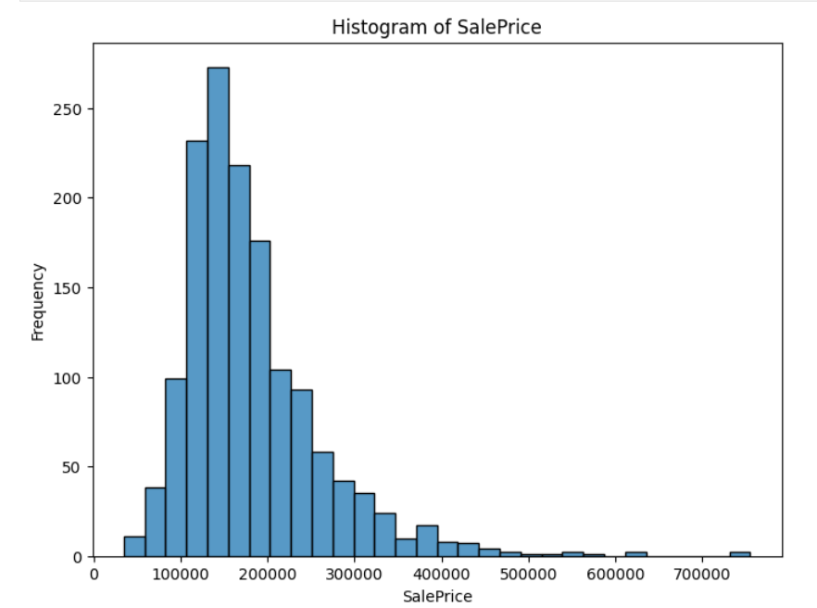
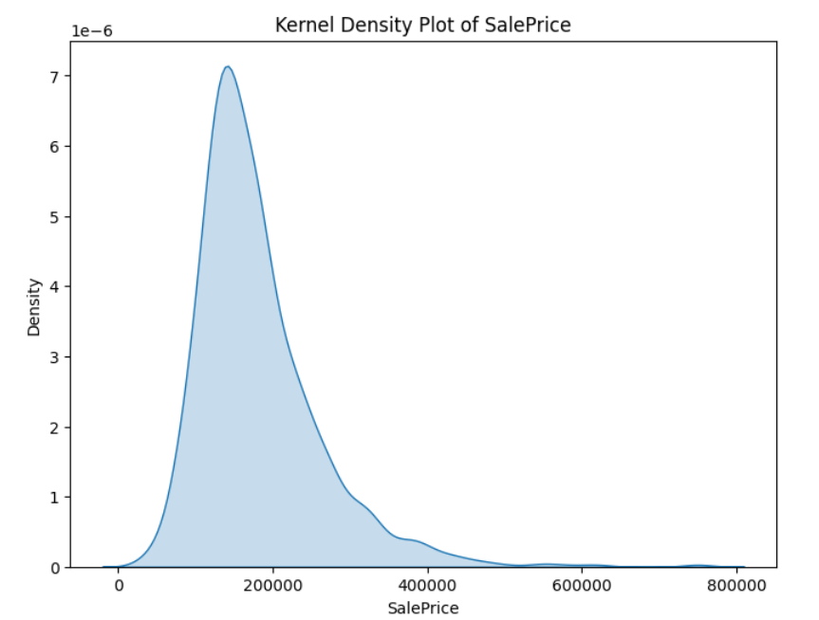
Univariate Analysis : -
Histograms and kernel density plots for key variables like Sale Price
Example distribution visualization (include a chart screenshot)

Slide 6
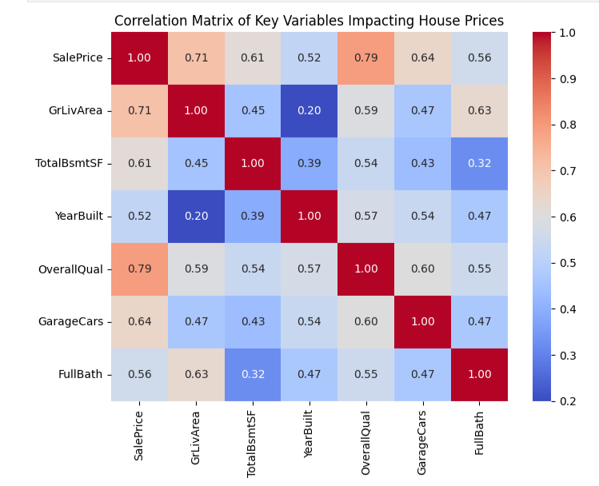
Multivariate Relationships: -
Correlation analysis heatmap for key features impacting Sale Price
Strong positive correlations with living area, quality, garage size
Visualized scatter plots for bedrooms, bathrooms, square footage vs price

Slide 7
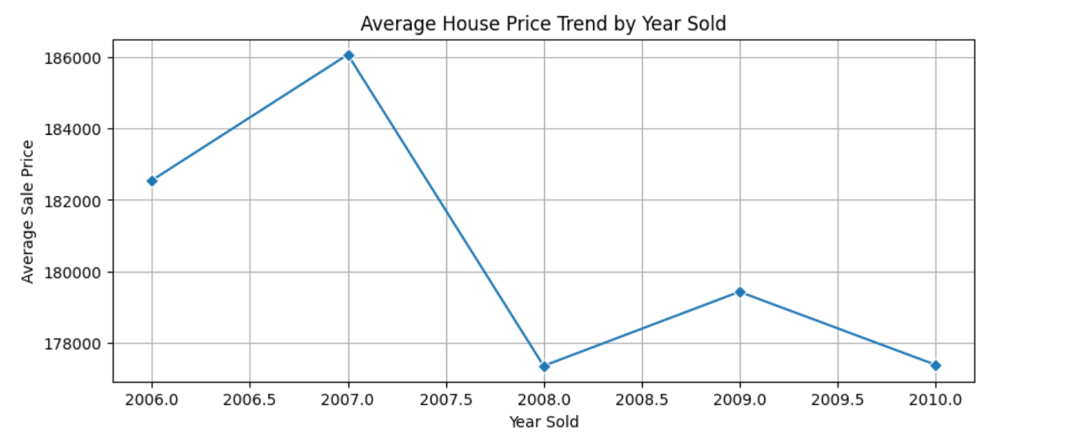
Temporal Trends: -
Average house price trends by year sold
Observed price changes across years.

Slide 8
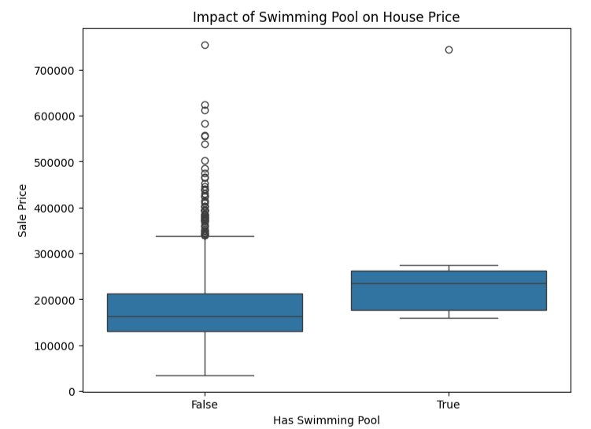
Amenities Impact: -
Explored how amenities like swimming pools and garage quality affect prices
Houses with pools tend to have higher price distributions
Garage quality positively correlated with prices

Slide 9
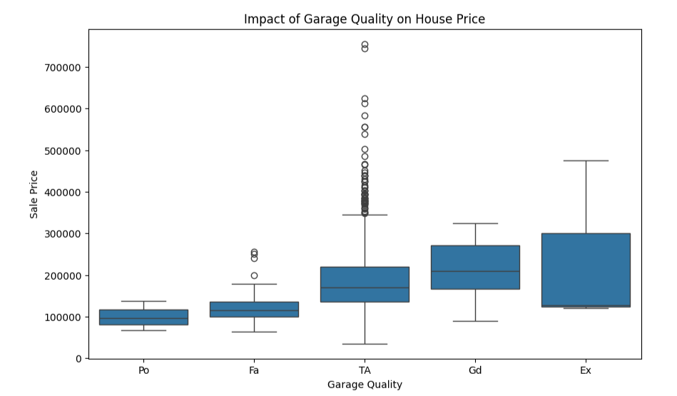
garage quality affect prices ---

Slide 10
Insights & Conclusions : -
Size, age, quality, and amenities significantly influence house prices
Temporal trends show market variability over years
Feature engineering improved understanding of sale price drivers
Recommendations for pricing analysis or modeling based on findings

Slide 11
Thank You So Much for your time and attention
END

